Slide 1

Exploratory Data Analysis
Domain Research and Exploratory Data Analysis
9/14/2019

Slide 2
agenda
Objectives / Goals
Data Management
Descriptions and location of related data
Issues with the data and how to address them
Descriptive statistics gathered as an initial step in analysis
High-Level Recommendations
Notes:
A written statement of the project overview and goal(s)
Descriptions and location of related data sources
An explanation of how you will manage the data for the project
Descriptive statistics you have applied as an initial step in data analysis
Any known issues with the data and how you plan to address them
Any initial insights you can glean from your quick look at the data. (Recall that you were previously ask to recommend three management-level decisions on the basis of your initial analysis.)

Slide 3



Objective/Goals
Increased visibility
Accurate billing
Energy management
Sub meters can help building owners in monitoring irregular usage patterns. Predictive analysis can also be carried out on equipment operating conditions and related energy wastage, permitting facility managers to check and repair equipment before failure points arise.
Notes:
A submeter is a digital meter that establishes two-way communication between the end-user and the concerned service provider. When paired with Energy Information System (EIS) it allows for effective energy management by providing highly granular data at few seconds intervals enabling very deep analytics. The analytics help informs the end-user of their individual energy usage pattern and suggests behavioral adjustments to cut down on electric cost.
https://amzur.com/blog/smart-submeter-track-monitor-and-manage-your-energy-billing/
Top 3 Benefits of smart sub meter
Increased visibility:
Unlike conventional energy meters, submeters collect and transmit telemetry data electronically. This helps curtail and prevent erroneous manual reading operations.
Accurate billing:
Units measured are units billed. With an alarm mechanism to detect tampering and rules to indicate above threshold values, submeters ensure more reliable and secure metering.
Energy management:
In addition to operational benefits to the facility managers, submeters also enable a more engaging experience for end-users by providing analytics on their energy usage. Submeters together with IoT integration have the ability to track and analyze energy consumption patterns. Submeters can help facility managers or building owners in monitoring irregular usage patterns. Predictive analysis can also be carried out on equipment operating conditions and related energy wastage, permitting facility managers to check and repair equipment before failure points arise. All these initiatives combined can lead to substantial savings for an organization or building.
Sub Meters are available for all three utility types: electric, water and gas.

Slide 4

Data Management
Smart Home Data
According to the movement route appliances use patterns
Before and after falling asleep user’s condition
Indoor environmental control with the temperature and humidity
Appliance On/Off
User’s Location
User’s condition
Indoor environment
Notes:
https://aquicore.com/blog/metering-submetering-property-managers-guide/
Collecting Data From SubMeters
Viewing and analysing SubMeter Data
Your smart meter records information about how much gas and electricity you’ve used, but doesn’t store other personal information that could identify you, such as your name, address or bank account. Your Energy Supplier will continue to hold your personal details on your account.
All this information about your energy use is strongly protected. strict controls are put on:
Your data
Who can access it
How you choose to share it

Slide 5



Descriptions and location of related data
Sceaux, France
 | SUB METER 1 | SUB METER 2 | SUB METER 3
TENANT SPACE | Kitchen | Laundry room | Other
APPLIANCES | dishwasher, oven and microwave | washing-machine, tumble-drier, refrigerator and light | electric water-heater and air-conditioner
NUMBER OF MEASUREMENTS | 2075259
PERIOD OF TIME | Between December 2006 and November 2010 (47 months)

Slide 6
known issues with the DATA
Data Set Characteristics: | Multivariate, Time-Series | Number of Instances: | 2075259 | Area: | Physical
Attribute Characteristics: | Real | Number of Attributes: | 9 | Date Donated | 2012-08-30
Associated Tasks: | Regression, Clustering | Missing Values? | Yes | Number of Web Hits: | 304953
Notes: 1.(global_active_power*1000/60 - sub_metering_1 - sub_metering_2 - sub_metering_3) represents the active energy consumed every minute (in watt hour) in the household by electrical equipment not measured in sub-meterings 1, 2 and 3.
2.The dataset contains some missing values in the measurements (nearly 1,25% of the rows). All calendar timestamps are present in the dataset but for some timestamps, the measurement values are missing: a missing value is represented by the absence of value between two consecutive semi-colon attribute separators. For instance, the dataset shows missing values on April 28, 2007.

Slide 7

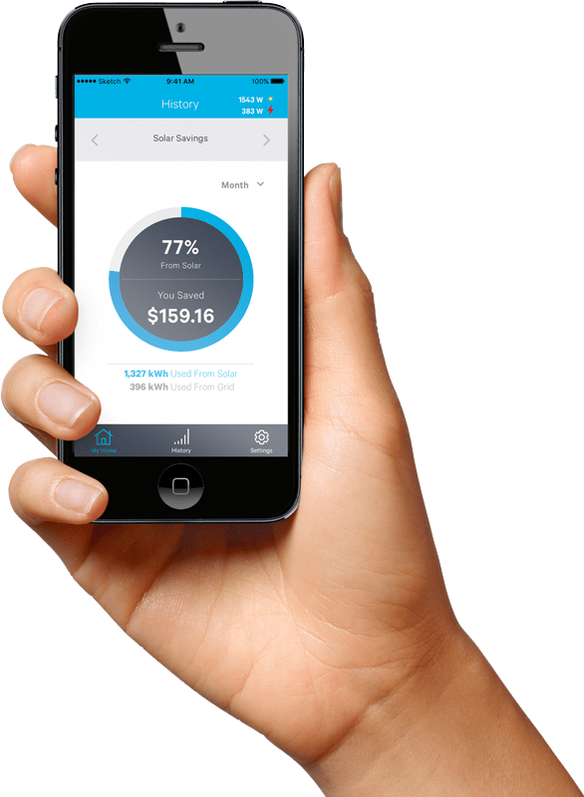
DATA MINING PROCESS
Business Understanding
Data
Understanding
1
2
SMART HOME SUB METER DATA
Data
Preparation
3
Deployment
Modeling
6
Evaluation
4
5

Slide 8

Descriptive statistics you gathered as an initial step in analysis
 | SUB METER 1 | SUB METER 2 | SUB METER 3
MIN. | 0.000 | 0.000 | 0.000
MEDIAN. | 0.000 | 0.000 | 1.000
MEAN. | 1.122 | 1.299 | 6.458
MAX. | 88.000 | 80.000 | 31.000
*in watt-hour of active energy

Slide 9
High-Level Recommendations
Separate appliances
Add more sub meters in the House
Add new Data such us:
number of people living in the house
Outside temperature

Slide 10


